Slide 1
DriverPass
A resource for student drivers
Notes:
Hello, and welcome to the DriverPass system. A system that is specifically designed for student drivers. Let’s get started.

Slide 2
System Requirements
Smartphones, computers, laptops, etc.
No hardware specific requirements
Notes:
System Requirements. The requirements of this system are very straight forward. There are no hardware specific requirements. All that will be needed is a device that has the ability to connect to the internet and browse the web.

Slide 3
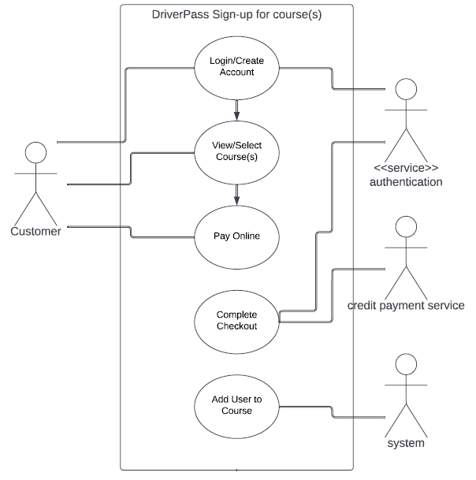
Use Case Example
Use Case shows the functionality of signing up for a course
Notes:
Next is a use case. The purpose of a use case is to show the functionality of a scenario in a project. In our case, a user will want to sign up for a course. In order to do so a user will need to sign-in to an existing account or create an account if one is not already made for the customer. From there the customer will need to select a package and the lesson or lessons that they would like to take. Then, the customer will need to pay online before the system will automatically add them to a course/lesson.

Slide 4
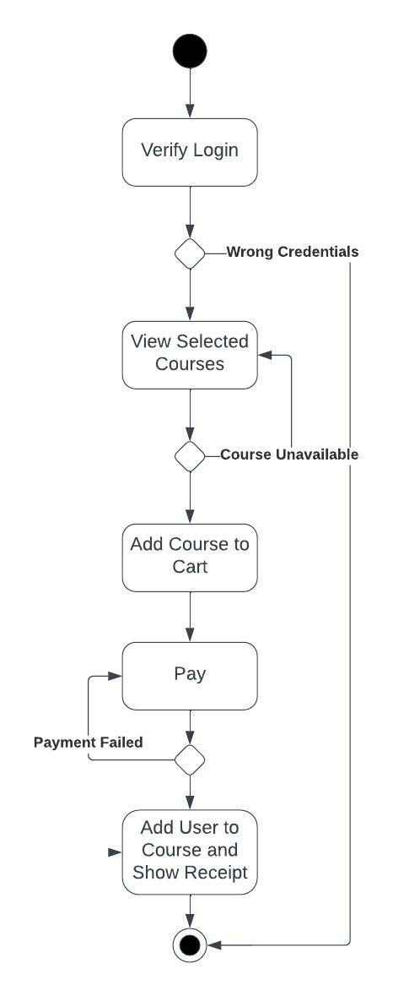
Activity Diagram
Activity Diagram shows the workflow of the same scenario of signing up for a course
Notes:
An activity diagram is a diagram that shows the conditions, constraints, sequential and concurrent activities. This means that it shows all the possibilities of a scenario. For example, if a customer attempts to login but uses incorrect credentials this diagram shows what would happen next (the user would need to try to login again). Same goes for selecting a course, if a course is unavailable, the system will prompt the user to select a different course. Finally if payment fails the customer will be prompt to try payment again.

Slide 5
Security
Roles
Encryption & Encapsulation
Brute-force Method
Admin Password Resets
Notes:
Security is very important .Which is why we designed the system to ensure that the system is as secure as it can be. Roles will be assigned to all staff which all have different levels of clearance. Admins will have full access to all systems and be able to edit and modify all aspects of the system as it needs to be. Instructors will have access to their students and lessons. Students will have access to use the system but not edit anything. To further enhance security, all personal information from users will be encrypted so outside parties can not obtain sensitive information. The brute force method is when someone attempts to get into an account by repeatedly guessing passwords. To combat this after a specific amount of tries the account will lock and no once can get in. This leads us to admin password rests, if a password is forgotten or an account is locked an administrator will have the ability unlock accounts and change passwords.

Slide 6
System Limitations
System is limited for use to devices with web application capabilities.

Slide 7
THANK YOU
Notes:
That us the end of my presentation on the DriverPass system. I hope you enjoyed and I hope that it meets all of your needs, thank you.

